Slide 1





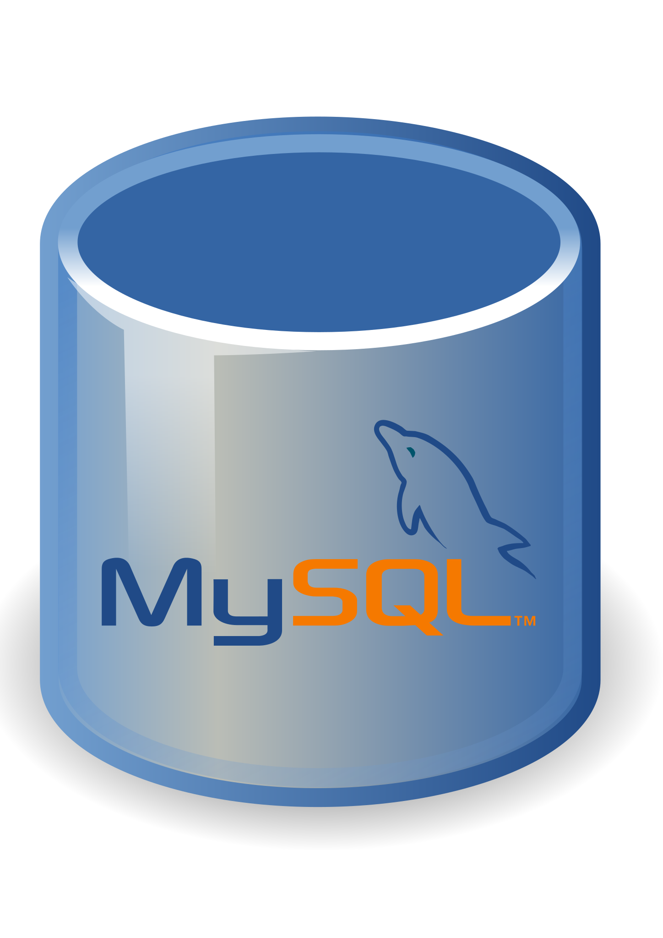


Differences between SQL and NoSQL
VS

Slide 2
Data Storage Model
SQL Databases
Tables with fixed rows and columns
NoSQL Databases
VS
Document: JSON documents, Key-value: key-value pairs, Wide-column: tables with rows and dynamic columns, Graph: nodes and edges

Slide 3
Development History
SQL Databases
Developed in the 1970s with a focus on
reducing data duplication
NoSQL Databases
VS
Developed in the late 2000s with a focus on scaling and allowing for rapid application change driven by agile and DevOps practices.

Slide 4
Examples
SQL Databases
NoSQL Databases
VS
Oracle, MySQL, Microsoft SQL Server, and PostgreSQL
Document: MongoDB and CouchDB, Key-value: Redis and DynamoDB, Wide-column: Cassandra and HBase, Graph: Neo4j and Amazon Neptune

Slide 5
Primary Purpose
SQL Databases
General purpose
NoSQL Databases
VS
Document: general purpose, Key-value: large amounts of data with simple lookup queries, Wide-column: large amounts of data with predictable query patterns, Graph: analyzing and traversing relationships between connected data

Slide 6
Schemas
SQL Databases
Rigid
NoSQL Databases
VS
Flexible

Slide 7
Scaling
SQL Databases
Vertical (scale-up with a larger server)
NoSQL Databases
VS
Horizontal (scale-out across commodity servers)

Slide 8
Multi-Record ACID Transactions
SQL Databases
Supported
NoSQL Databases
VS
Most do not support multi-record ACID transactions. However, some — like MongoDB — do.

Slide 9
Joins
SQL Databases
Typically required
NoSQL Databases
VS
Typically not required

Slide 10
Data to Object Mapping
SQL Databases
Requires ORM (object-relational mapping)
NoSQL Databases
VS
Many do not require ORMs. MongoDB documents map directly to data structures in most popular programming languages.

